Slide 1
Carvana - IsBadBuy?
Group 8
Emely Callejas, Ashley Cortez,
Rithvik V Sourab, Angelica Verduzco

Slide 2
Case Background & Problem
Established in 2012, Carvana Co. provides an online service for buying used cars, offering options for delivery or pickup in certain, mainly southern US, states.
As of 2017, Carvana expanded to 60 metropolitan markets with nearly 10,000 pre-owned vehicles.
Carvana’s growth strategy is dependent on integrated supply chain, an exclusive software system and data analytics
The main focus on the case revolves around using a logistic regression for predictive analysis to determine primary factors influencing whether a car is a bad buy(IsBadBuy).

Slide 3
Categorical Variables Available in the Data Set
Auction: Auction provider at which the vehicle was purchased
VehYear: Manufacturer’s year of the vehicle
Make: Vehicle Manufacturer
Model: Vehicle Model
Trim: Vehicle Trim Level
SubModel: Vehicle Submodel
Color: Vehicle Color
Transmission: Vehicle transmission type (Automatic, Manual)
WheelTypeID: The type id of the vehicle wheel
WheelType: The vehicle wheel type description (Alloy, Covers)
Nationality: The Manufacturer’s Country
Size: The size category of the vehicle (Compact, SUV, etc.)
TopThreeAmericanName: Identifies if the manufacturer is one of the top three American manufacturers
PRIMEUNIT: Identifies if the vehicle would have a higher demand than standard price
AUCGUART: The level guarantee provided by auction for the vehicle (Green Light - Guaranteed/arbitrable, Yellow Light - caution/issue, red light - sold as is)
VNST: State where the car was purchased
IsOnlineSale: Identifies if the vehicle was originally purchased online
VNZIP1: Zipcode where the car was purchased
PurchDate: The date the vehicle was purchased at Auction
Variables in Yellow = Used in Logistic Regression

Slide 4
Numerical Variables Available in the Data Set
IsBadBuy: Identifies if the kicked vehicle was an avoidable purchase
VehicleAge: Year elapsed since manufacturer’s year
MMRAcquisitionAuctionAveragePrice: price for this vehicle in average condition at time of purchase
MMRAcquisitionAuctionCleanPrice: price for this vehicle in the above Average condition at time of purchase
MMRAcquisitionRetailAveragePrice: price for this vehicle in the retail market in average condition at time of purchase
MMRAcquisitionRetailCleanPrice: price for this vehicle in the retail market in above average condition at time of purchase
MMRCurrentAuctionAveragePrice: price for this vehicle in average condition as of current day
MMRCurrentAuctionCleanPrice: price for this vehicle in the above condition as of current day
MMRCurrentRetailAveragePrice: price for this vehicle in the retail market in average condition as of current day
MMRCurrentRetailCleanPrice: price for this vehicle in the retail market in above average condition as of current day
VehBCost: acquisition cost paid for the vehicle at time of purchase
WarranyCost: Warranty price (term=36month and millage=36k)
BYRNO: Unique number assigned to buyer that purchased the vehicle
Variables in Yellow = Used in Logistic Regression

Slide 5
Variables Omitted from Logistic Regression
95% NULL Values
95% NULL Values
These fields had attributes that had significant amounts of Bad Buys, however they had low significance levels when added to logistic regression model and were not influential when included in the Odds Ratio analysis
PRIMEUNIT
AUCGUART
Auction, Color, Nationality, Trim, Sub Model, Transmission

Slide 6
Variables Focused on for Logistic Regression
Approach to Selecting Independent Variables:
Conduct exploratory research of training dataset by using Excel and Tableau visualizations to determine which attributes within each categorical variable contain the highest count of Bad Buys
Select specific attributes within each variable to include in logistic regression
E.g., Make - Chevrolet, Model - PT Cruiser, States - TX, FL, etc.
Each independent variable was analyzed to check its significance level based on p-values
Odds Ratio analysis was also used to determine a variable’s influence on the dependent variable.
See slide 7 for more details
Dependent Variable
IsBadBuy
Independent Variables
VehicleAge
lnVehBCost
VehYear_2005
Make_Chevrolet
Model_PTCRUISER
State_TX
State_FL
WheelType_Alloy
WheelType_Covers
WheelType_Special
VNZIP1_27542
VehSize_MediumSUV
MMRCurrentRetailAveragePrice
MMRCurrentAuctionAveragePrice
MMRAcquisitionRetailAveragePrice
MMRAcquisitionAuctionAveragePrice
Yellow = Specific attribute within variable

Slide 7
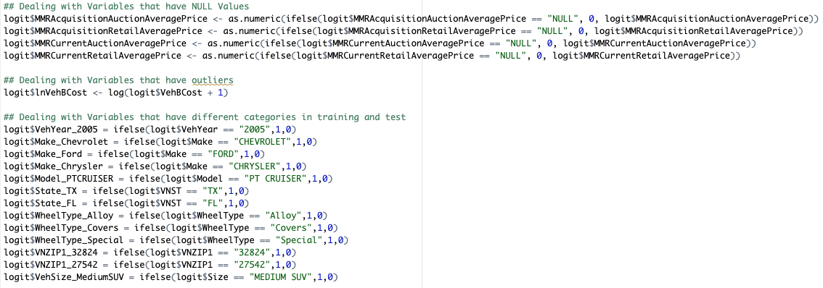
Transform & Clean Data
In the snapshot above, we are transforming and cleaning the variables that our included in our model.
NULL variables in acquisition prices are replaced with 0. VehBCost is standardized to account for outliers.
New columns are created for categorical variables to create new dummy variables.

Slide 8
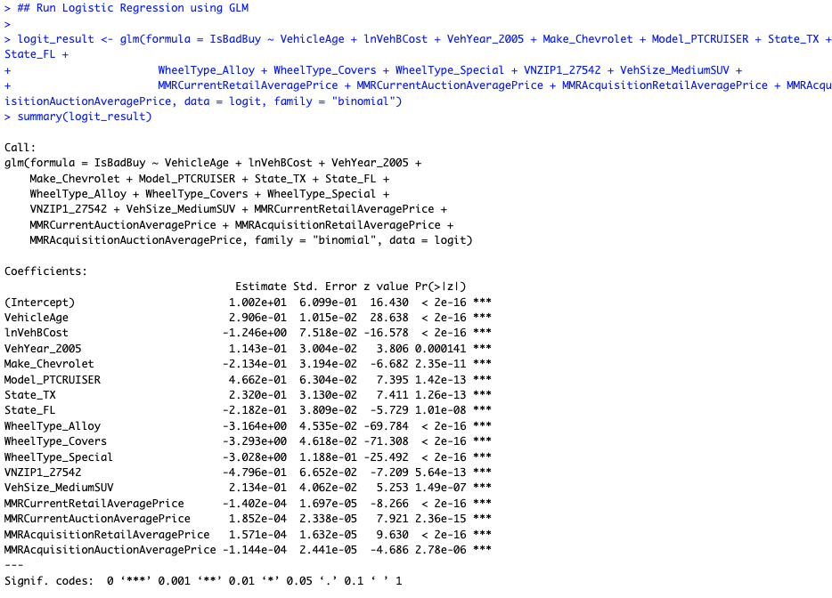
Logistic Regression Model
When including categorical variables, we were sure to check that the p-value was 0.001 (indicated by ***)
With this analysis we were able to narrow down the most influential variables.
Variables that were not included (mentioned on slide 5) often had a p-value that was 0.05 or lower, indicating a low significance.
Wheel Type variables had the most surprising estimates and z-values.

Slide 9
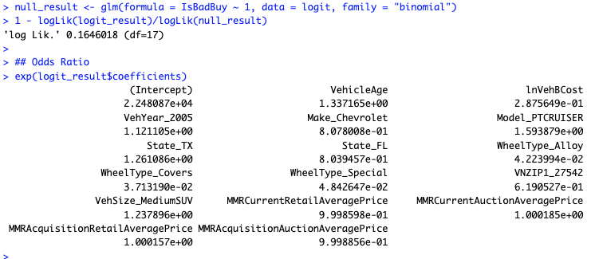
Pseudo R-Square and Odds Ratio
We also checked the fit of the model with the Pseudo R-Square.
Through trial and error of adding and removing variables in the model, we found that this is the highest r-square value from the various combinations
The odds ratio is the exponential of the coefficients and can be interpreted as such:
For every unit increase of each variable, the odds of the dependent variable changing are influenced (positively or negatively)
E.g., for every increase in VehicleAge, the odds of Bad Buy increases by 33.7%

Slide 10
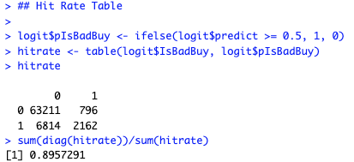
Hit Rate Table
The Hit Rate Table offered us a clear view of what the model is predicting accurately and inaccurately.
Insights
True Negatives: 63,211 - correctly predicted non-Bad Buys
True Positives: 2,162 - correctly predicted Bad Buys
False Positives: 796 - Non-Bad Buys incorrectly labeled as Bad Buys
False Negatives: 6,814 - Bad Buys missed by the model
Model Accuracy: 89.57%
Indicates a high level of correct overall predictions

Slide 11
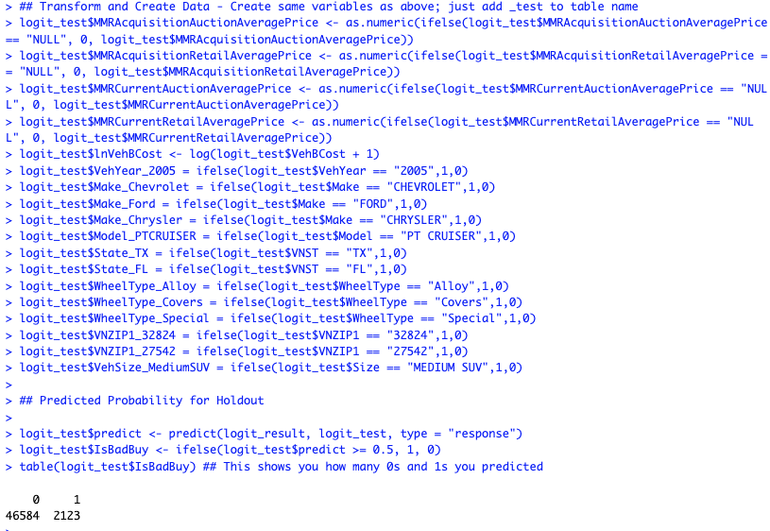
Predict Bad Buy on Test Data Set
With what the model learned from the training data, 2,123 Bad Buys were predicted within the test data.
This accounts for approximately 4.4% of the 48,707 records in the test data set
In the training data, ~12% of the records were identified as Bad Buys. It is important to recall that the hit table on the previous slide shows an 89% accuracy rate, which may explain why there is a lower percentage of Bad Buys predicted in the test data set.

Slide 12
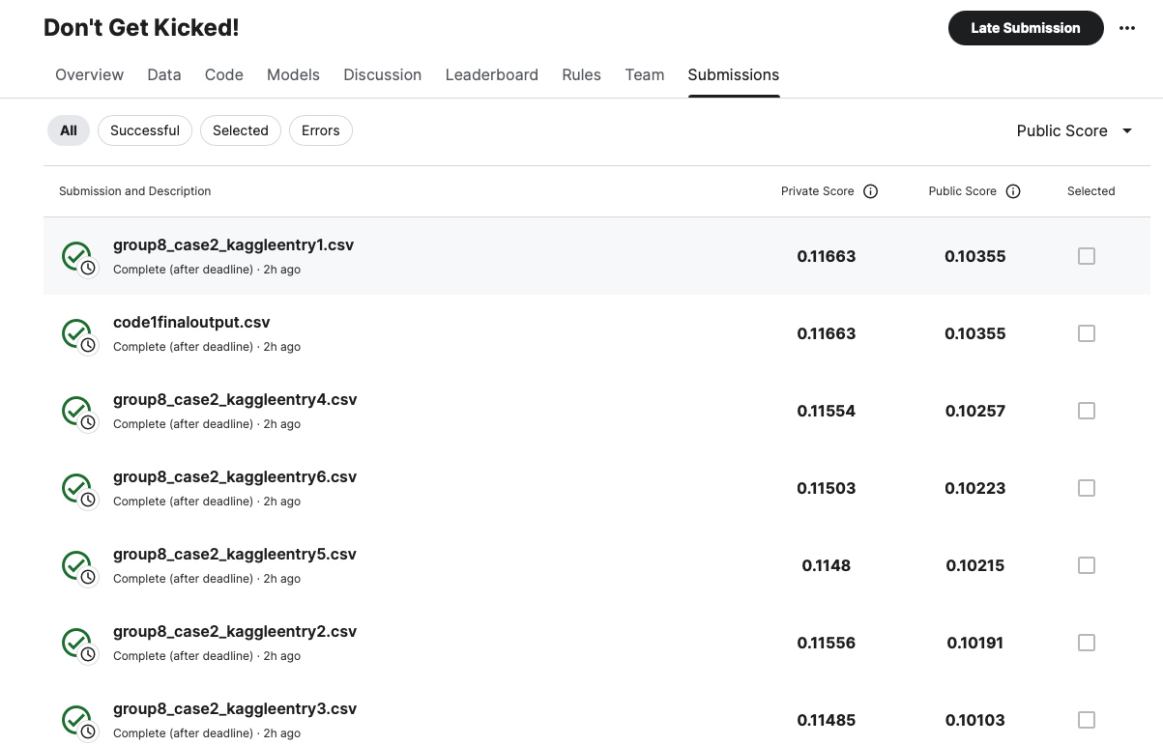
Kaggle Submission Results

Slide 13
Kaggle Submission Results - Conclusion
We tried multiple combinations of independent variables to see how they’d affect our overall score in the Kaggle submission.
The independent variables we included in this presentation resulted in the highest score as well as the highest r-square
Variables like VehicleAge, Make, Model, and State are included because they are known to affect a car's value and reliability, which could indicate a higher chance of being a bad buy. Also, choosing states such as TX and FL since they are populous states and represent a big amount of the data. These all were expected variables.
However, we have excluded variables like color or features with less impact with other features.
Some of the surprising variables were as follows:
VehYear_2005: We believe that there was perhaps a recall on a certain car that made this specific year impactful
Wheel Type (Alloy, Covers, Special): We believe buyers think certain wheel types are associated with vehicle quality/care.

